Slide 1
Lecture 7
JOINS.
Inner Join. Full Join. Left Join.
Right Join. Cross Join. Natural Join.
Self Join.

Slide 2
PostgreSQL JOINS.
PART I. PostgreSQL JOINS. Inner Join. Full Join. Left Join. Right Join.
PART II. Cross Join. Natural Join. Self Join.

Slide 3
PART I. PostgreSQL JOINS. Inner Join. Full Join. Left Join. Right Join.

Slide 4
PostgreSQL Joins
The SQL Join clause is used to combine data from two or more tables in a database. When the related data is stored across multiple tables, joins help you to retrieve records combining the fields from these tables using their foreign keys.
Following is the basic syntax of a the SQL JOIN CLAUSE: SELECT column_name(s)
FROM table1 JOIN table2;

Slide 5
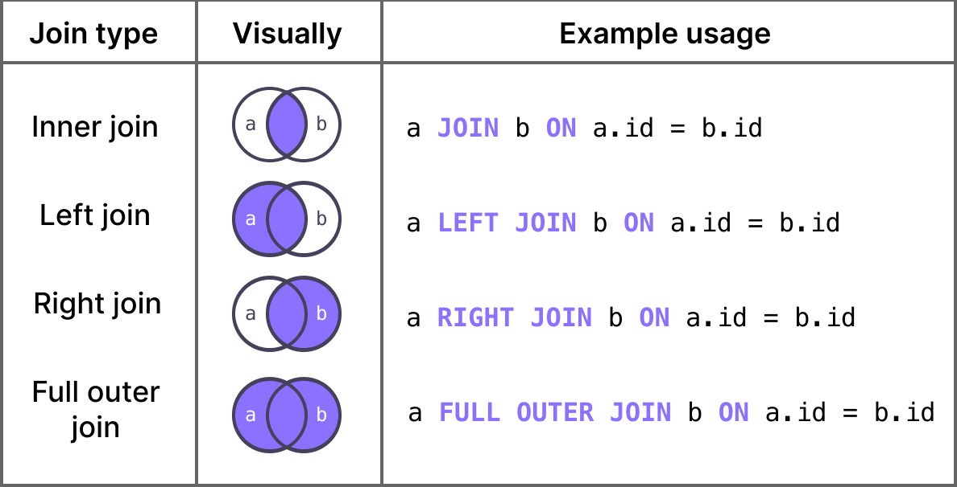

Slide 6
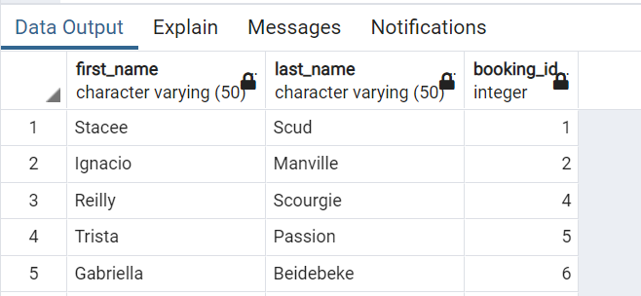
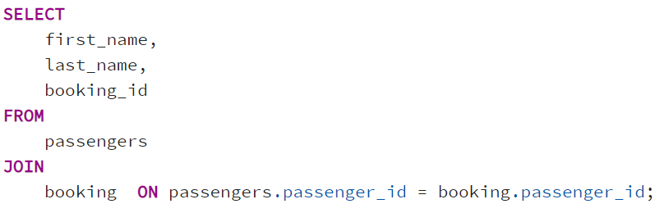
Example

Slide 7
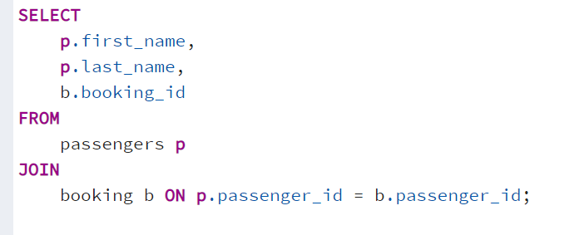
Example

Slide 8
Explanation
SELECT: Specifies the columns you want to retrieve.
FROM: Indicates the primary table (passengers) you are querying from.
JOIN: Combines rows from passengers and booking based on the matching condition.
ON: Specifies the condition for the join (matching passenger_id in both tables).

Slide 9
The SQL Inner Join
The SQL Inner Join is a type of join that combines multiple tables by retrieving records that have matching values in both tables (in the common column).
Following is the basic syntax of SQL Inner Join:
SELECT column_name(s)
FROM table1 INNER JOIN table2
ON table1.column_name = table2.column_name;

Slide 10
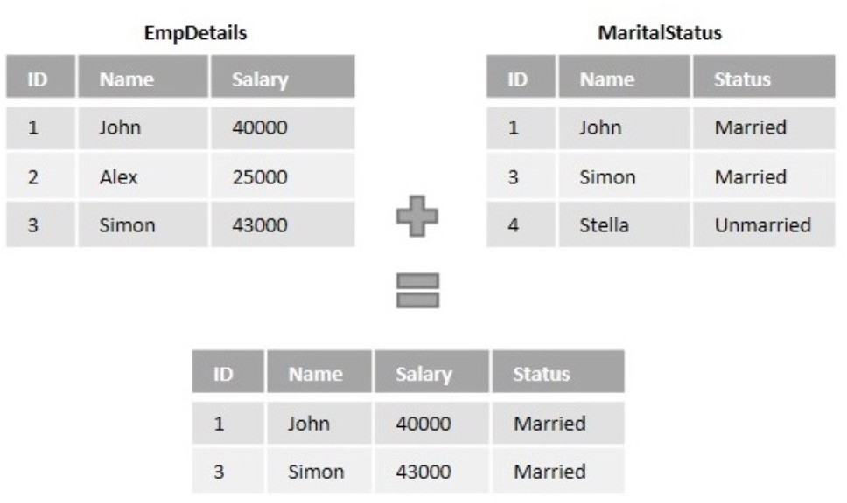
Explanation of Inner Join

Slide 11
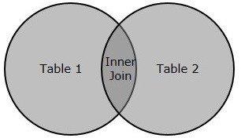
The following Venn diagram illustrates the inner join:

Slide 12
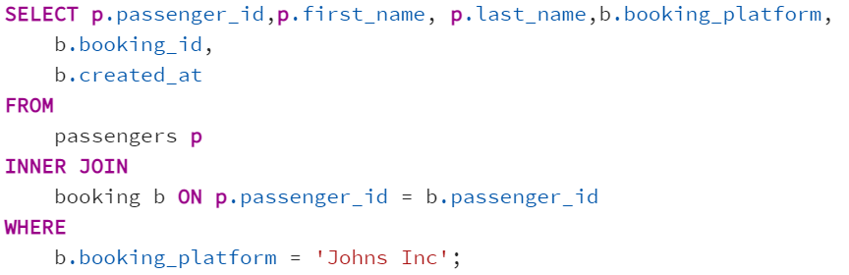
Example

Slide 13
Joining Multiple Tables Using Inner Join
It is possible to join as many tables as possible, using Inner Join, by specifying the condition :
SELECT column1, column2, column3...
FROM table1
INNER JOIN table2
ON condition_1 INNER JOIN table3 ON condition_2
....
INNER JOIN tableN ON condition_N;

Slide 14
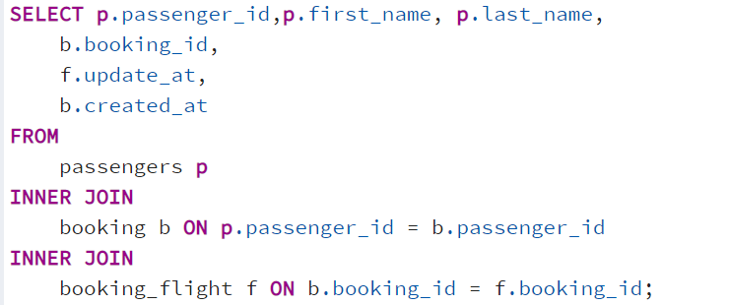
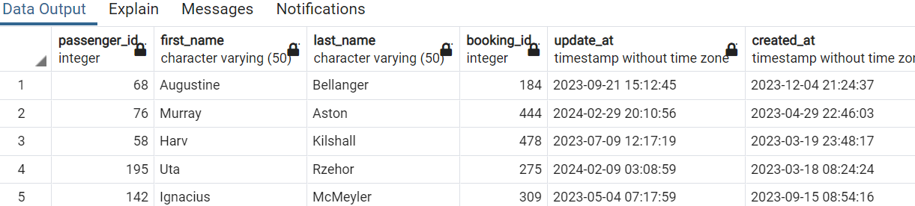
Example

Slide 15
The SQL OUTER Join
An Outer Join retrieves all the records in two tables even if there is no counterpart row of one table in another table, unlike Inner Join.
Following are the different types of outer Joins:
LEFT JOIN − returns all rows from the left table, even if there are no matches in the right table.
RIGHT JOIN − returns all rows from the right table, even if there are no matches in the left table.
FULL JOIN − returns rows when there is a match in one of the tables.

Slide 17
The SQL Left Join
Left Join or Left Outer Join in SQL combines two or more tables, where the first table is returned wholly; but, only the matching record(s) are retrieved from the consequent tables.
Following is the basic syntax of Left Join in SQL: SELECT column_name(s)
FROM table1 LEFT JOIN table2
ON table1.column_name = table2.column_name;

Slide 18
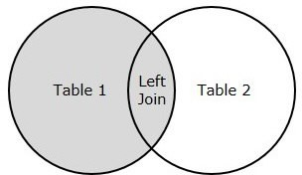
The following Venn diagram illustrates the left join:

Slide 19
The SQL Right Join
The Right Join or Right Outer Join query in SQL returns all rows from the right table, even if there are no matches in the left table.
Following is the basic syntax of Right Join in SQL: SELECT table1.column1, table2.column2...
FROM table1
RIGHT JOIN table2
ON table1.common_field = table2.common_field;

Slide 20
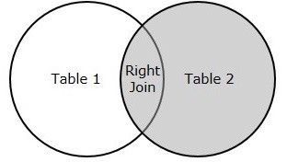
The following Venn diagram illustrates the right join:

Slide 21
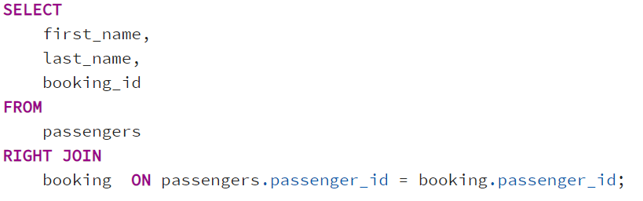
Example

Slide 22
The SQL Full Join
SQL Full Join creates a new table by joining two tables as a whole. The joined table contains all records from both the tables and fills NULL values for missing matches on either side.
Following is the basic syntax of Full Join in SQL:
SELECT column_name(s)
FROM table1
FULL JOIN table2
ON table1.column_name = table2.column_name;

Slide 23
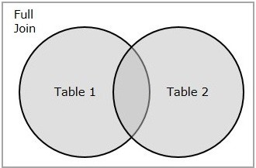
The following Venn diagram illustrates the full outer join:

Slide 24
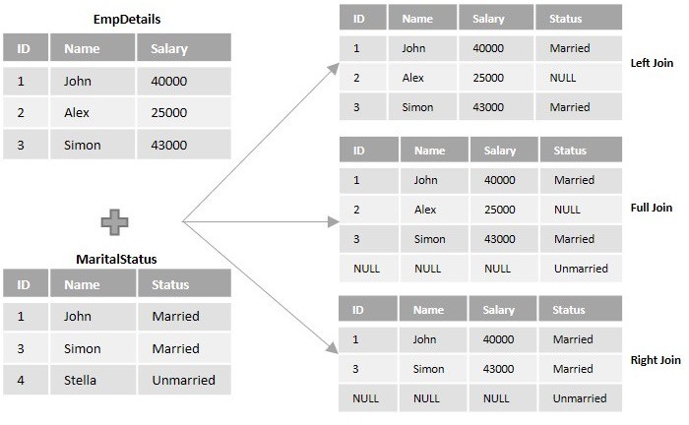
Outer join explanation

Slide 25
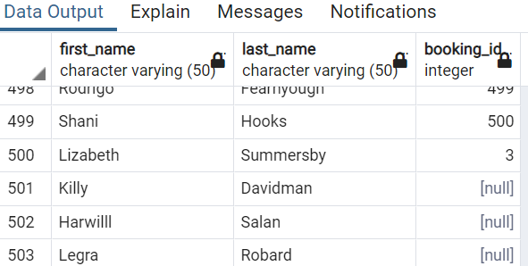
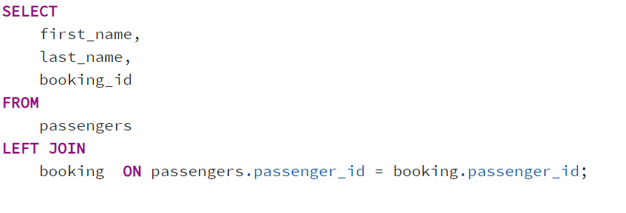
Example

Slide 26
PART II. Cross Join. Natural Join. Self Join.

Slide 27
SQL NATURAL JOIN
A natural join is a join that creates an implicit join based on the same column names in the joined tables.
The following shows the syntax of the PostgreSQL natural join: SELECT select_list
FROM T1
NATURAL [INNER, LEFT, RIGHT] JOIN T2;

Slide 28
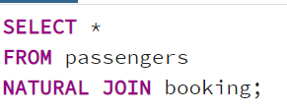
SQL NATURAL JOIN examples

Slide 29
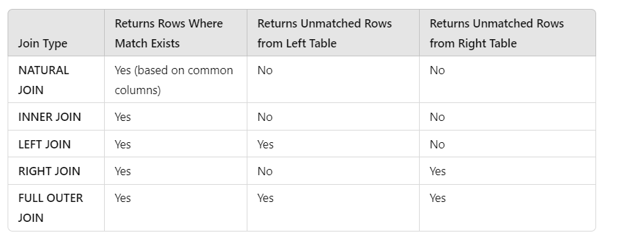
Differences

Slide 30
Differences
NATURAL JOIN is convenient for combining tables with multiple common columns, but it can lead to unexpected results if not managed carefully.
INNER JOIN is precise for matching records in both tables.
LEFT JOIN, RIGHT JOIN, and FULL OUTER JOIN provide more flexibility for including records even when matches don’t exist, with different orientations (left or right) depending on the focus of the query.

Slide 31
SQL Self-Join
A self-join is a regular join that joins a table to itself. In practice, you typically use a self-join to query hierarchical data or to compare rows within the same table.
The following query uses an INNER JOIN that joins the table to itself: SELECT select_list
FROM table_name t1
INNER JOIN table_name t2 on join_predicate;

Slide 32
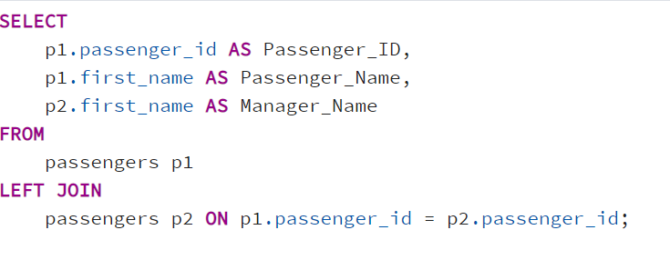
Example

Slide 33
SQL Cross Join
A CROSS JOIN clause allows you to produce a Cartesian Product of rows in two or more tables.
The following illustrates the syntax of the CROSS JOIN syntax: SELECT select_list
FROM T1
CROSS JOIN T2;

Slide 34
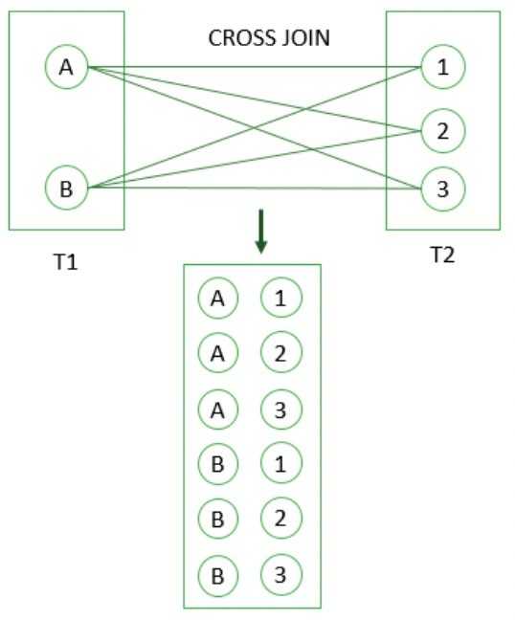

SQL CROSS JOIN example

Slide 35
